Slide 1
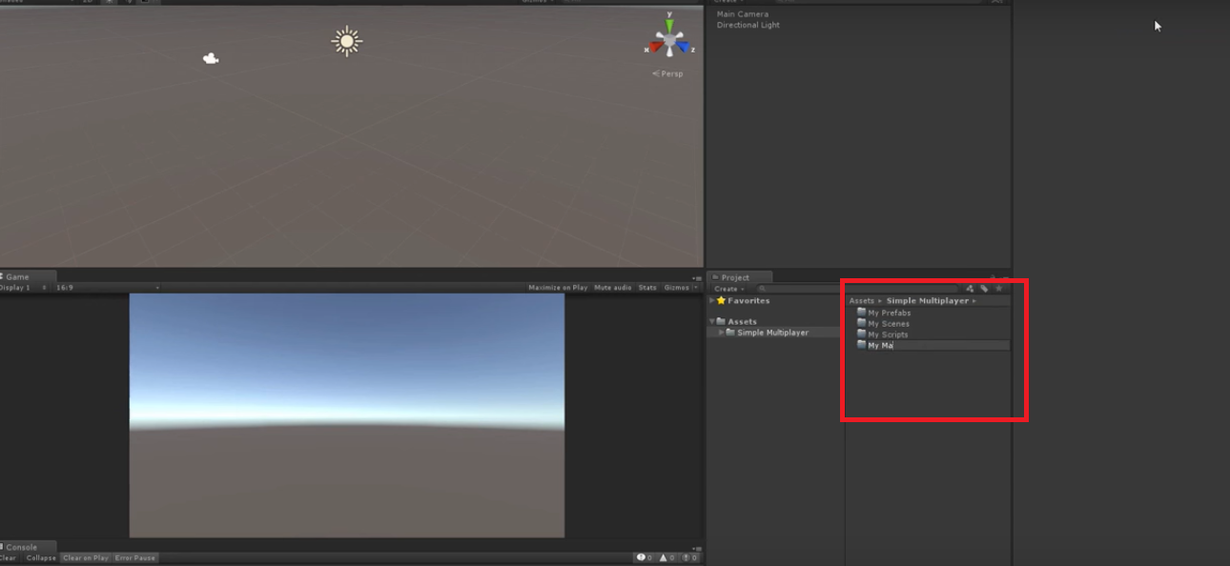
STEP1: Hierarchy
1.Save Scene

Slide 2
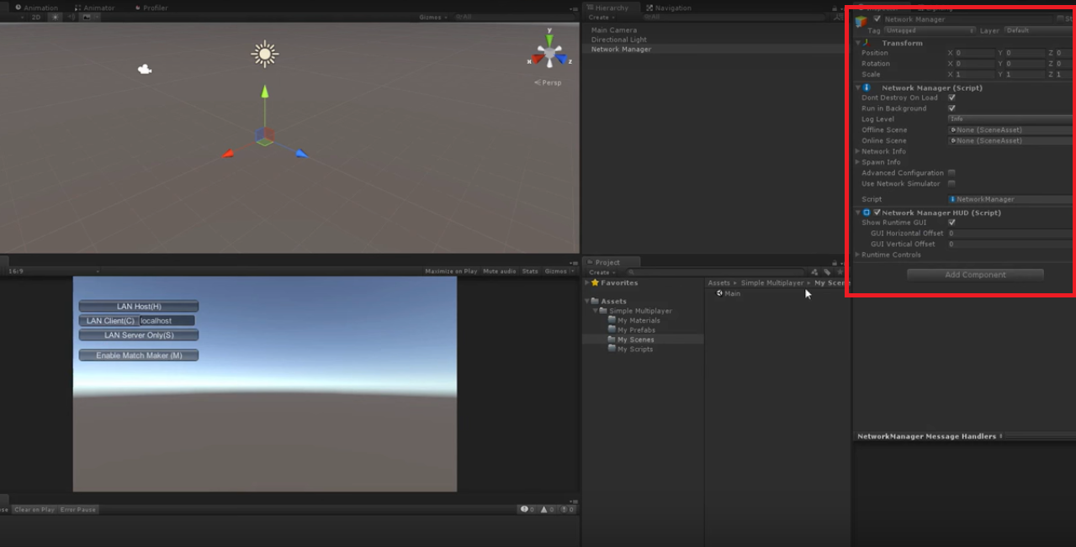
Step 2: Network manager
1.Add Empty Game Object
2.Add network Manager
3.Add network HUD

Slide 3
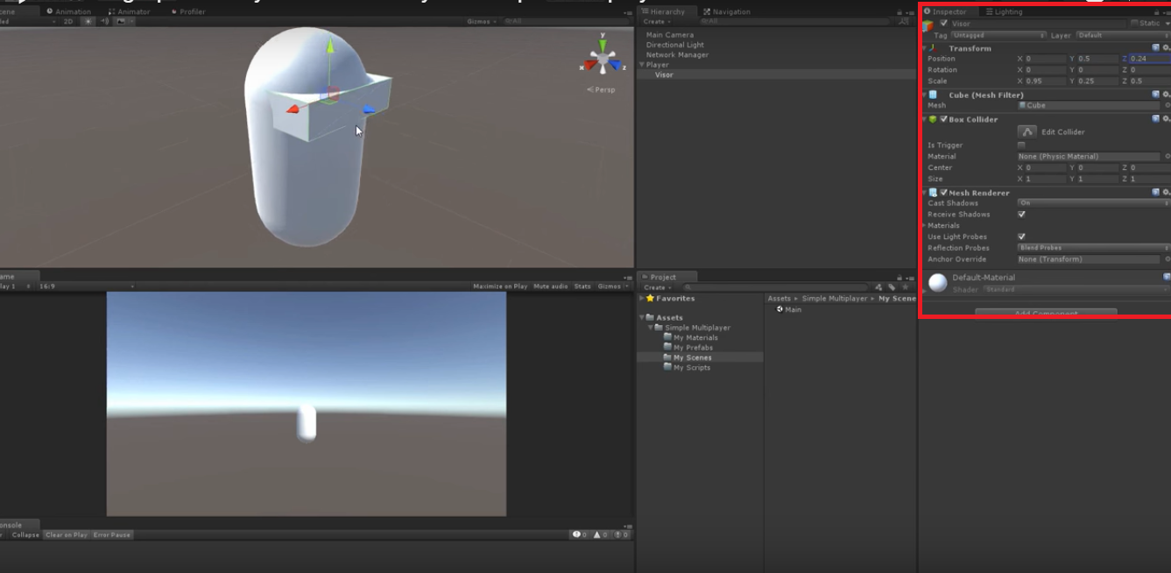
STEP 3:Making Simple Player

Slide 4
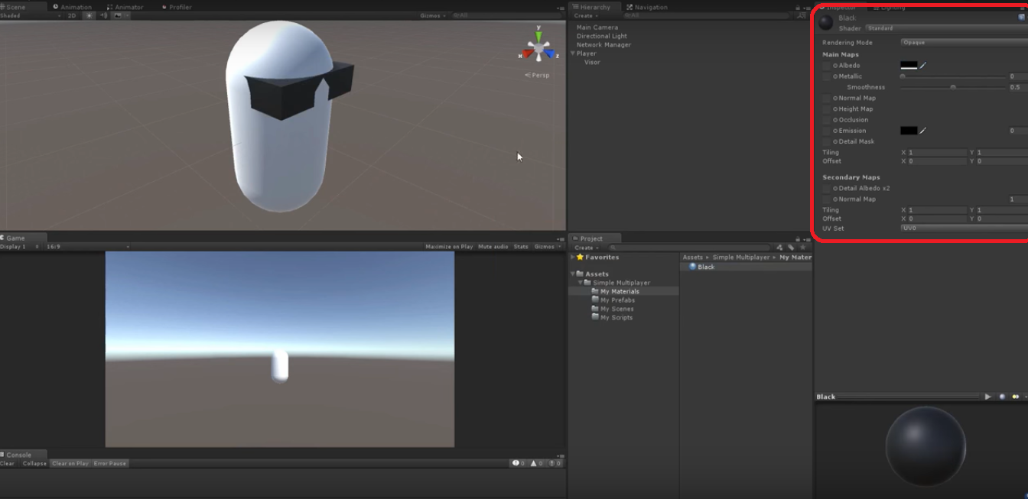
Simple Player

Slide 5
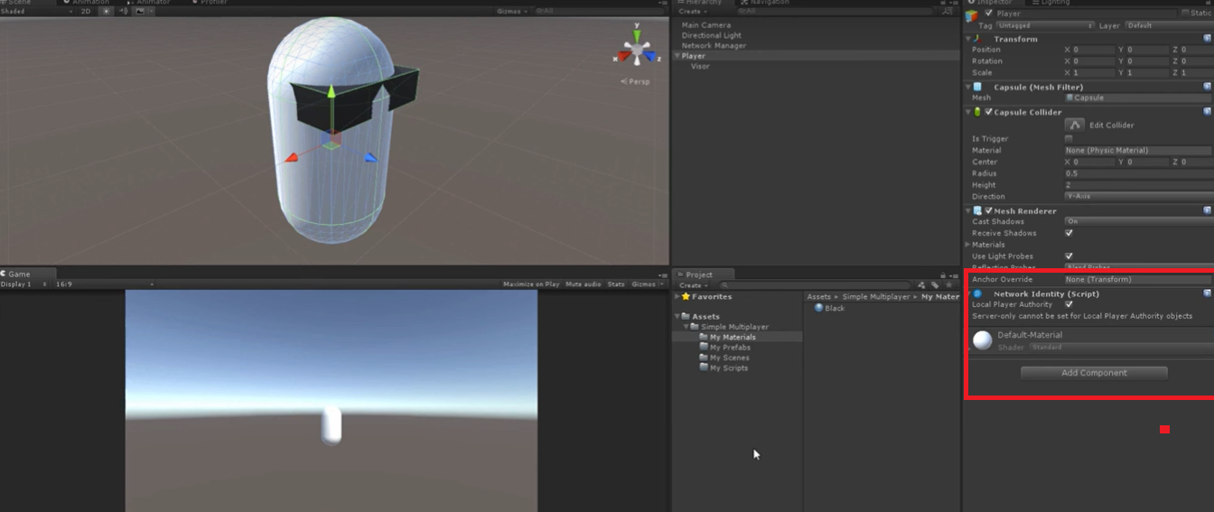
Player Prefabs and delete form Scene
1.Add player identity on local host
2.Add the player in prefabs and delete from scene

Slide 6
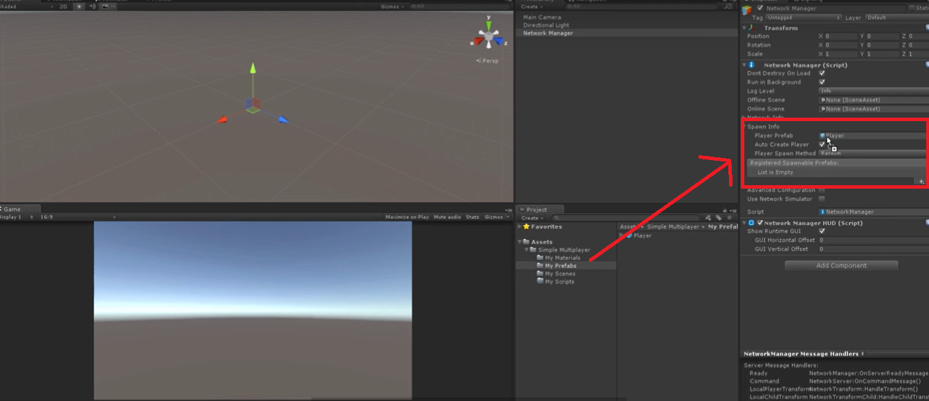
Register The Player Prefabs
1.Register the player to network manager

Slide 7
1.Create a c# script 2.write the script 3.Attach with player.
Creating the Player Movement

Slide 8
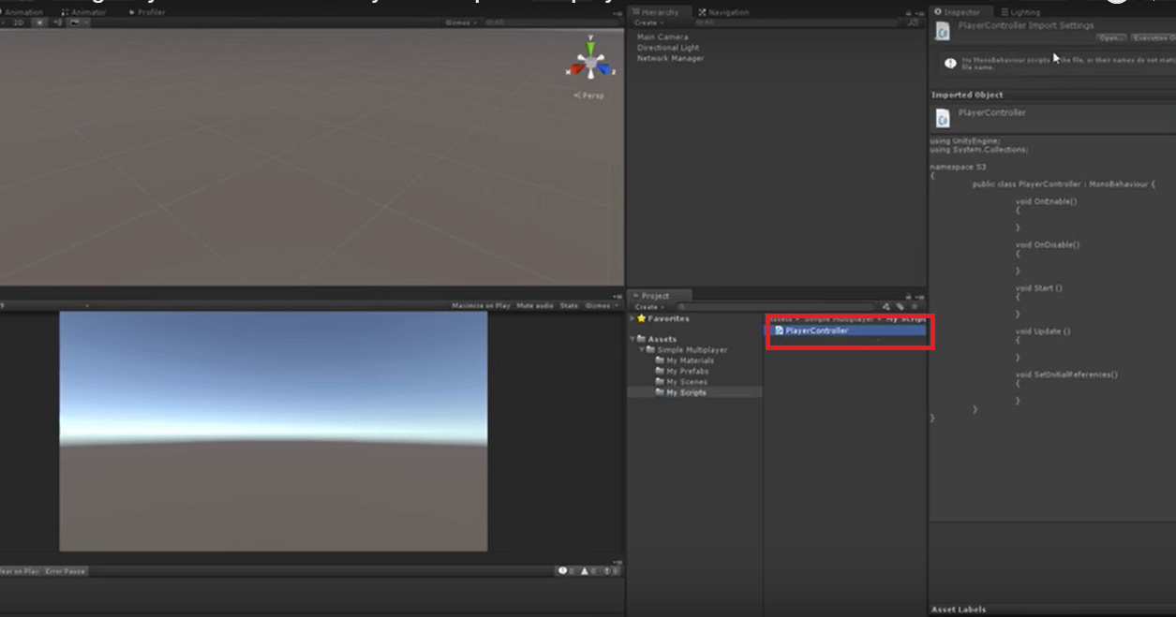
Creating the Player Movement

Slide 9
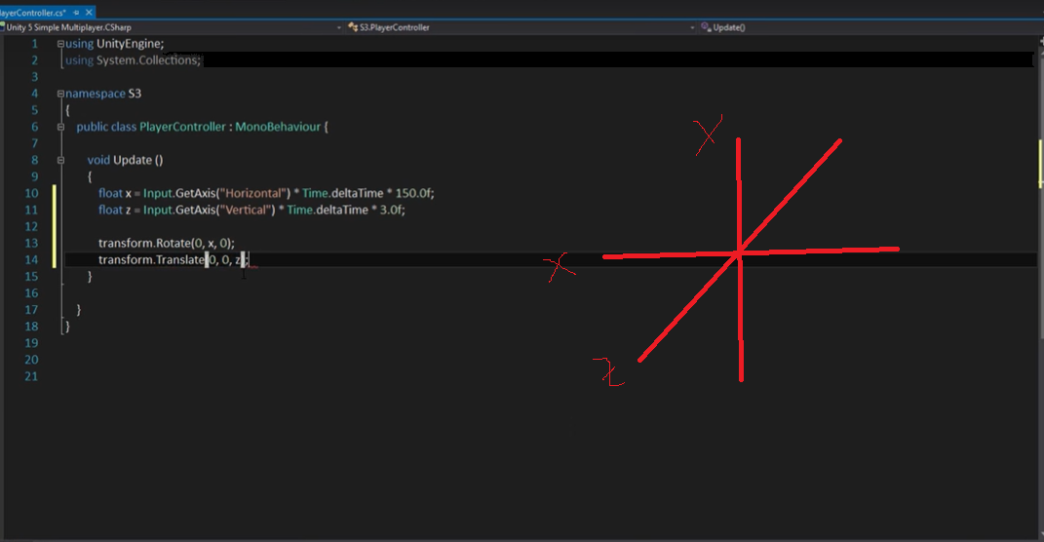

Slide 10
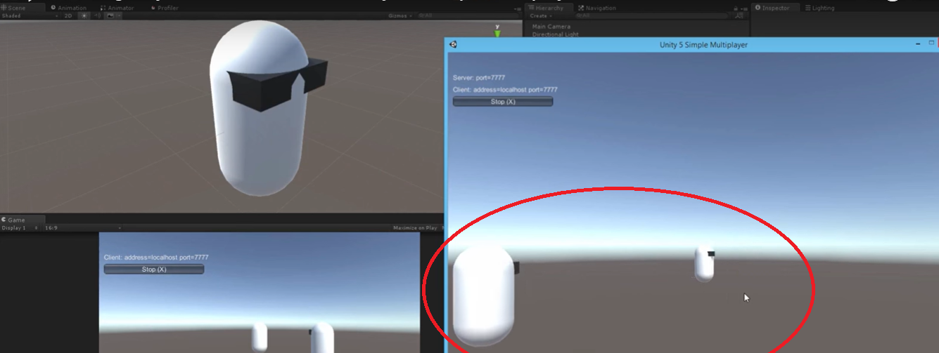
Checking Player movement Online
1.Build the game
2.See Port number and local Host
3.Check movements

Slide 11
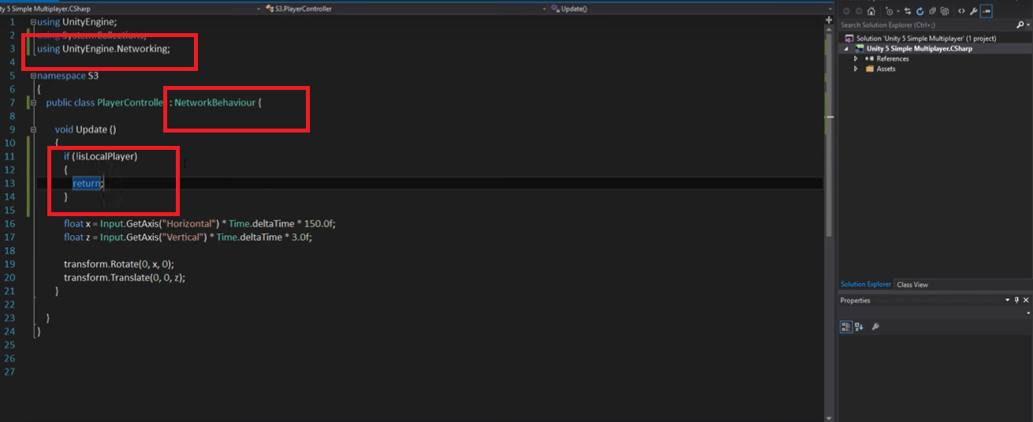
Networking the Player Movement

Slide 12
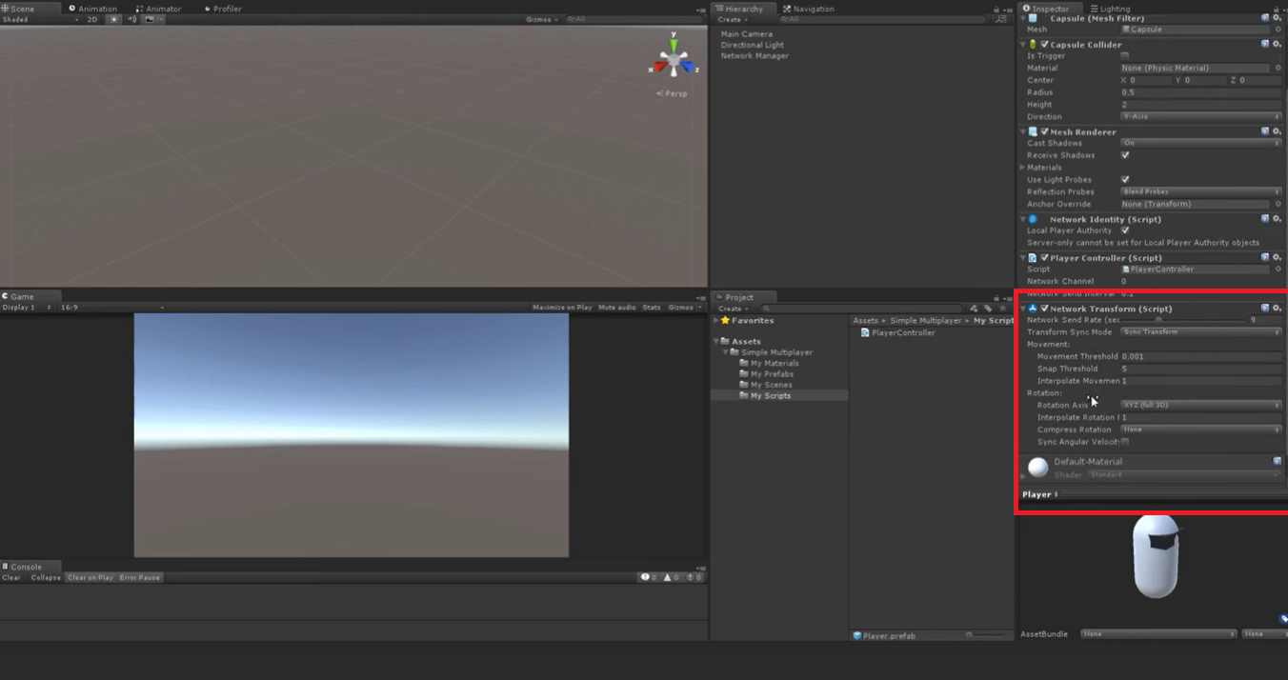
1.Check player network Identity 2.change the script 3.add Network Transform
Networking the Player Movement

Slide 13
Nothing Something
Testing Multiplayer Movements
YOU

Slide 14
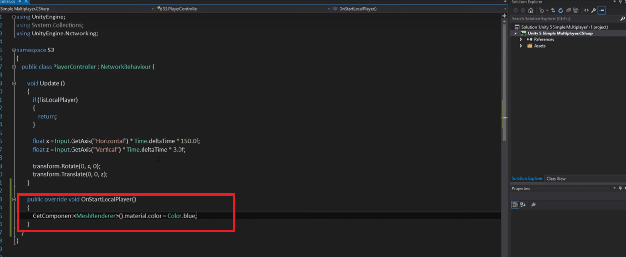
Identifying the Local Player

Slide 15
1. Write the script 2.Add fire method 3.Create bullet 4.Add Rigid Body 5.create Gun 6.Add spawn f bullet 7.Attach them with Script
Shooting (Single Player)

Slide 16
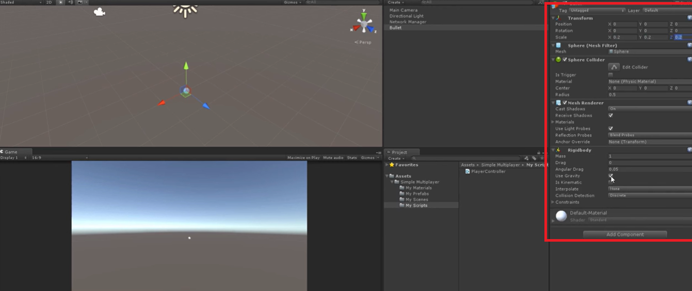

Slide 17
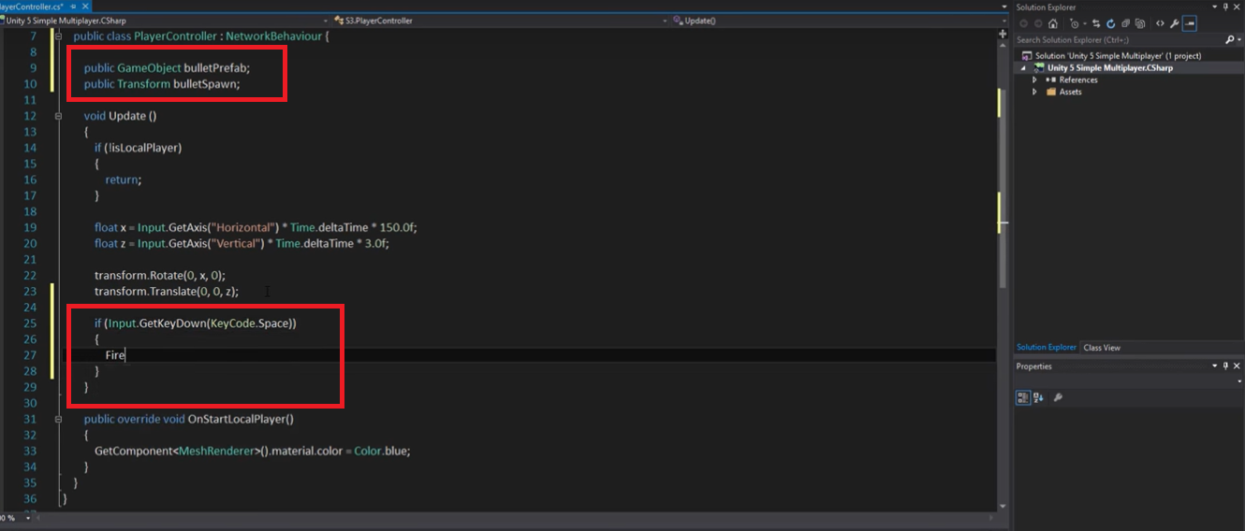

Slide 18
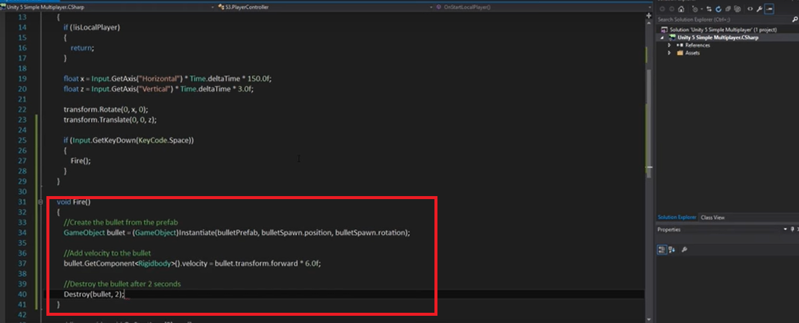

Slide 19
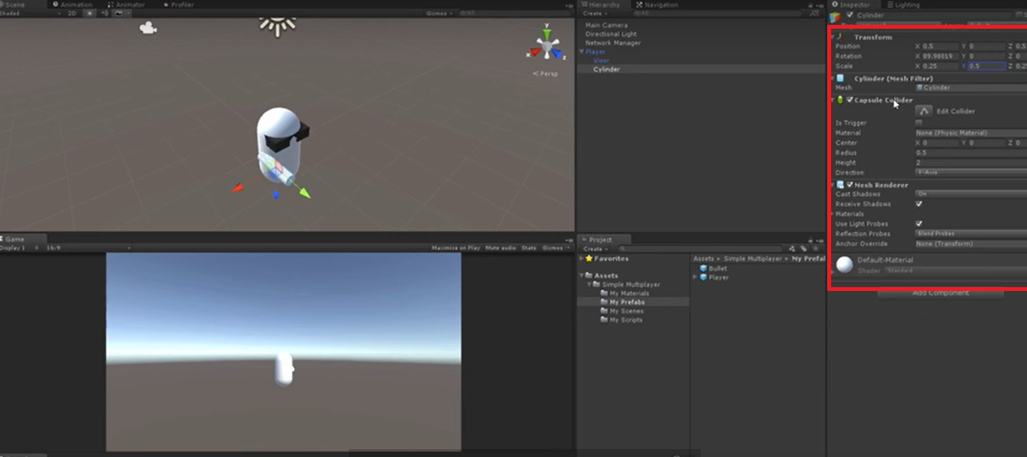

Slide 20
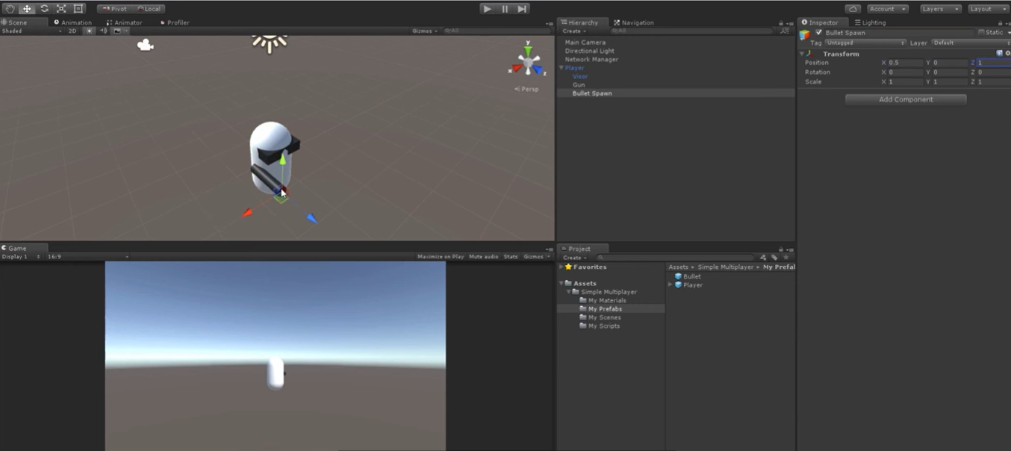

Slide 21
Adding Multiplayer Shooting
1.Add identity and transform to bullet
2.Register to network manager
3.Change some Script
4.Destory the bullet on collision (on collision enter)

Slide 22
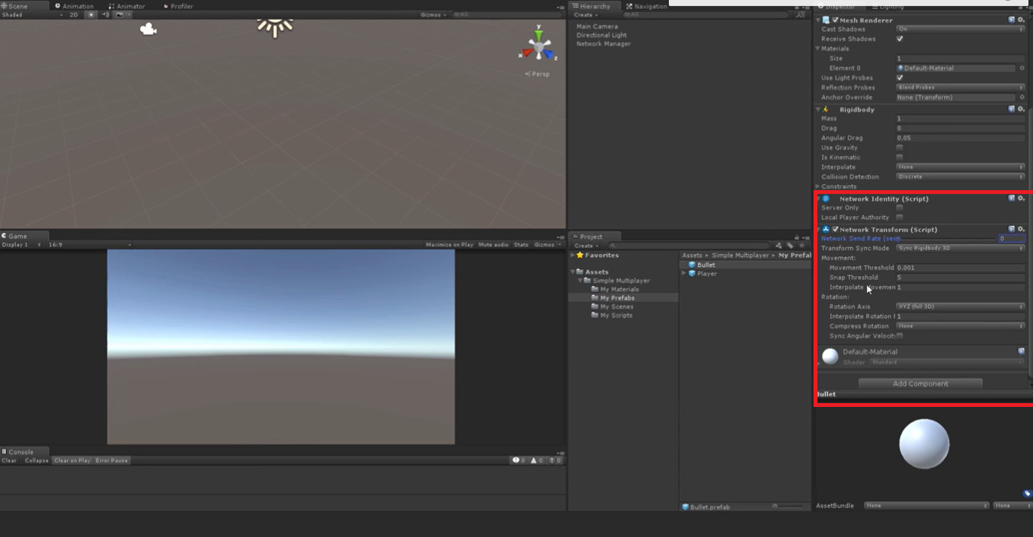

Slide 23
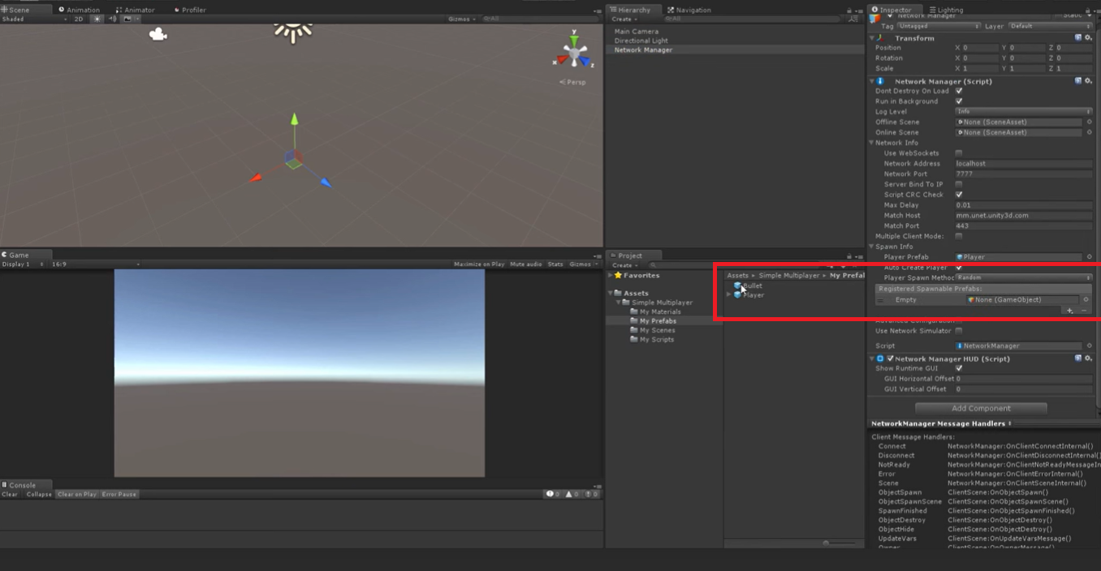

Slide 24
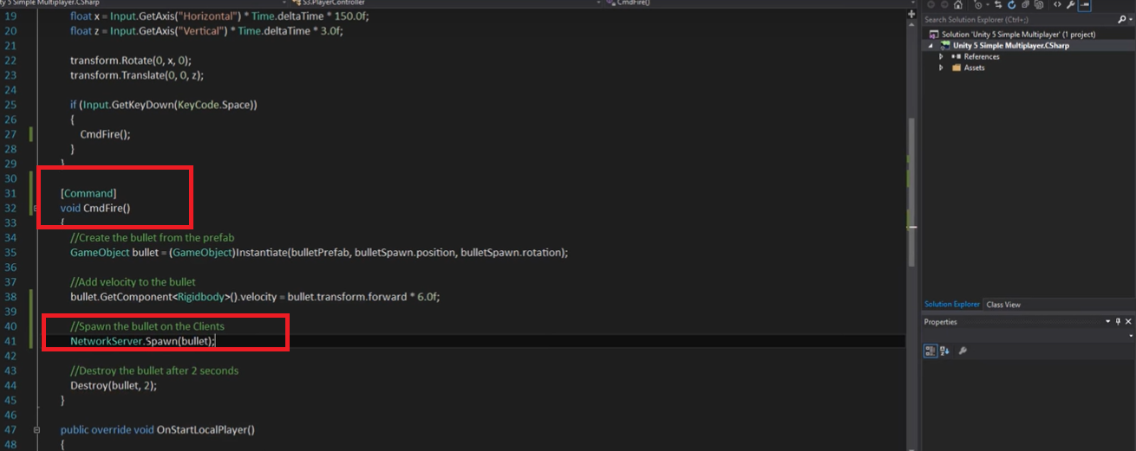

Slide 25
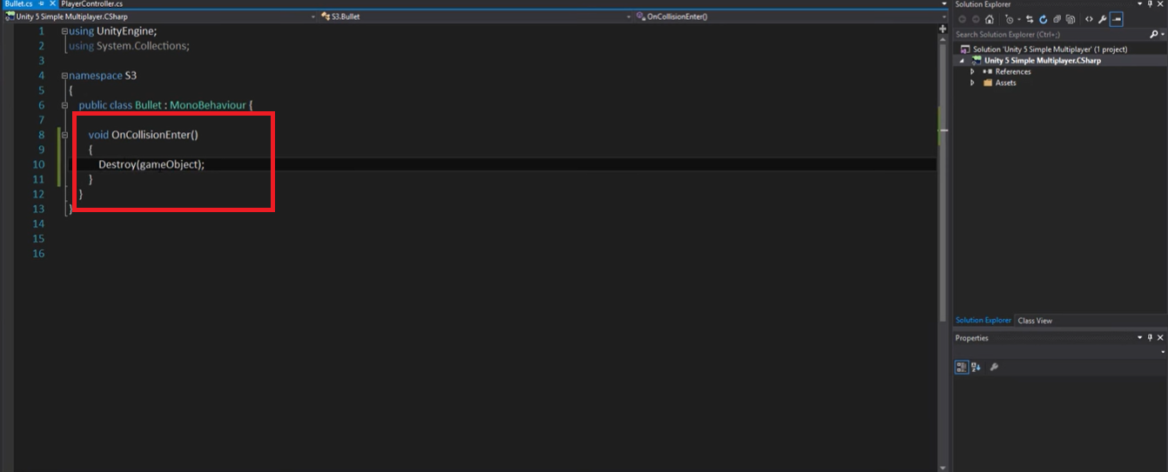

Slide 26
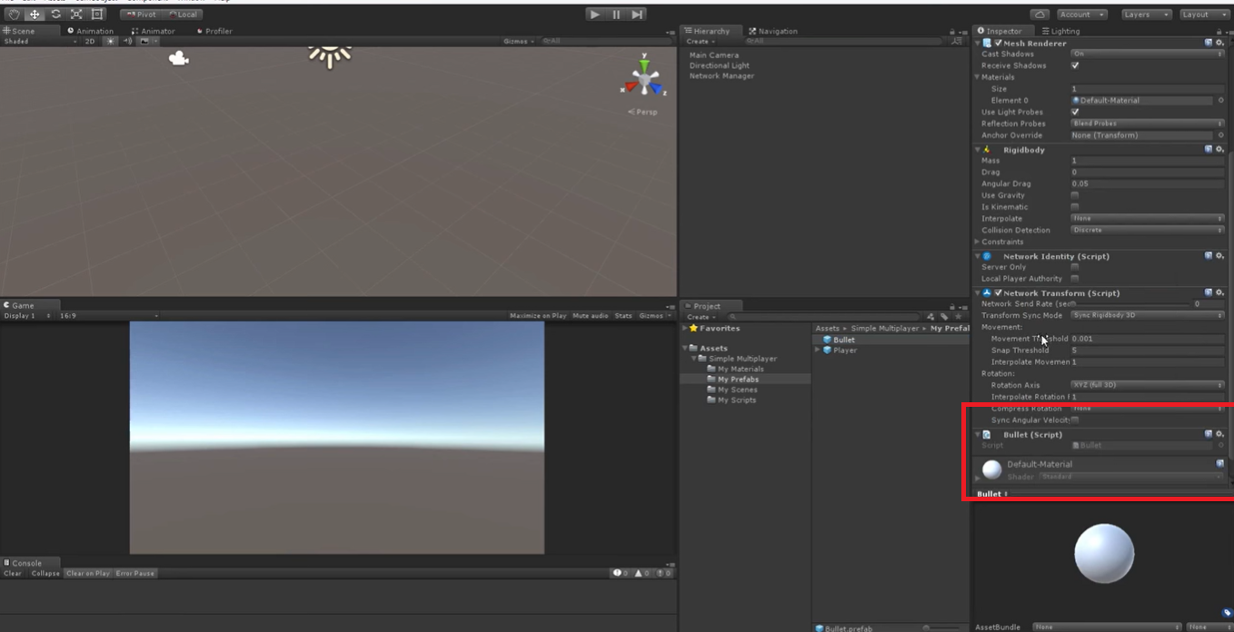

Slide 27
1.Create a script heath 2.Attach to the Player 3,update bullet script 4.Add the health UI 5.Focus the camera to heath
Heath☺

Slide 28
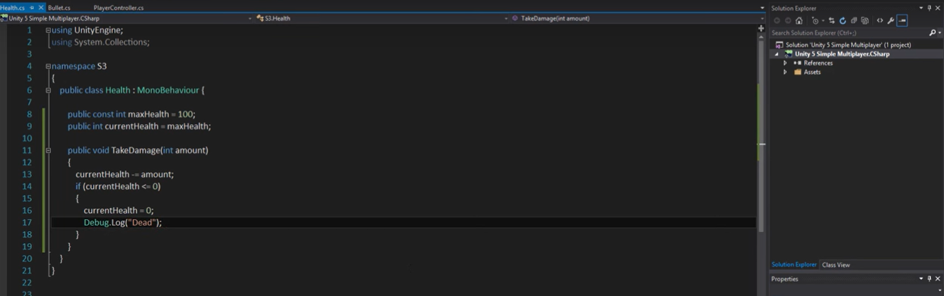
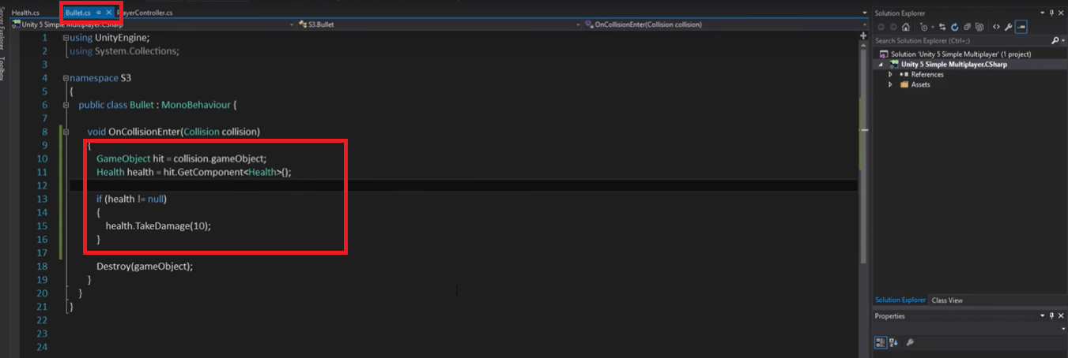

Slide 29
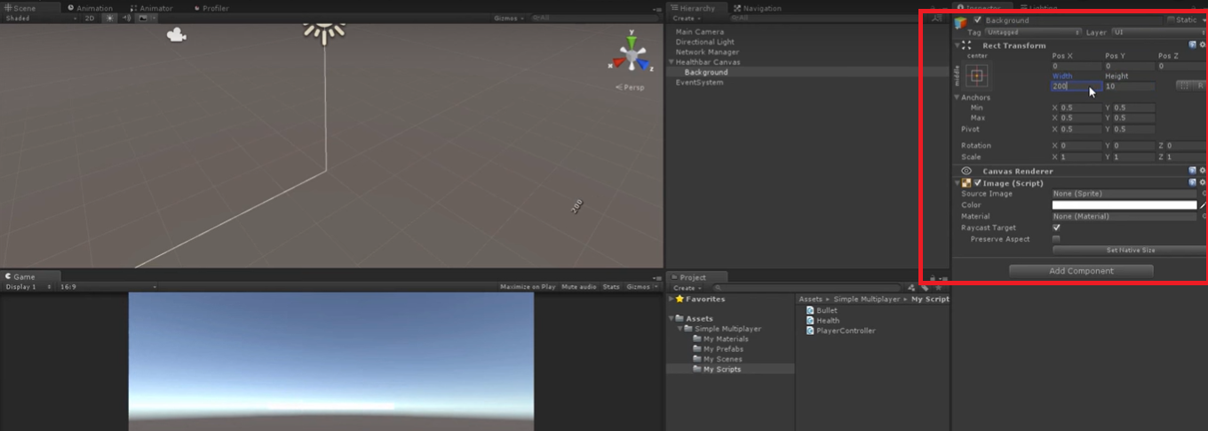
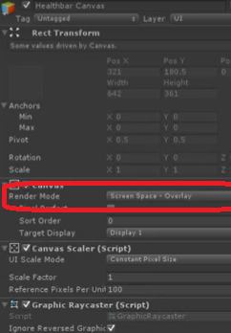

Slide 30
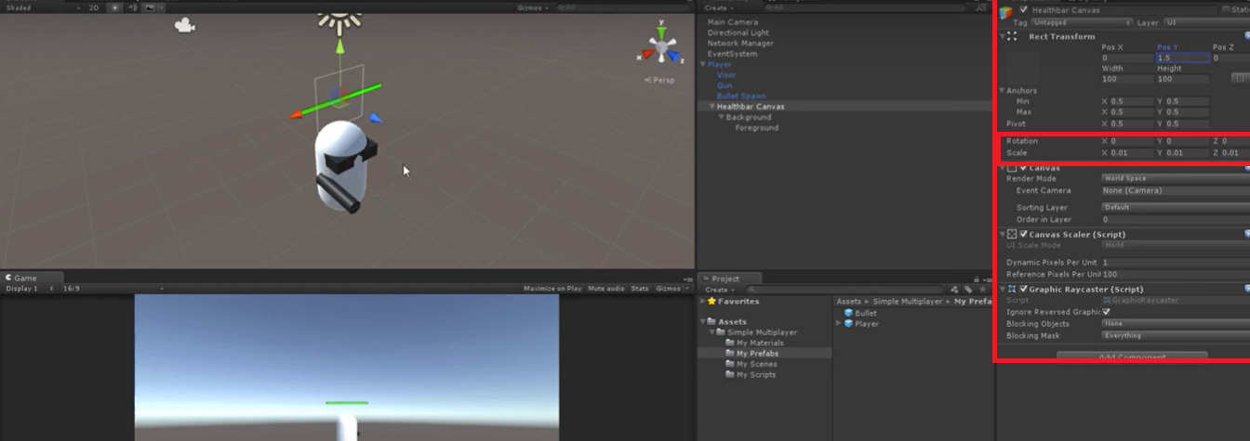

Slide 31
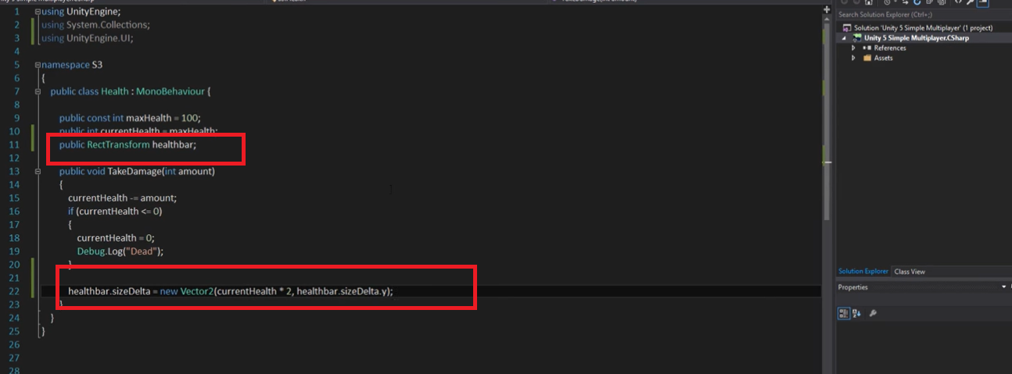

Slide 32
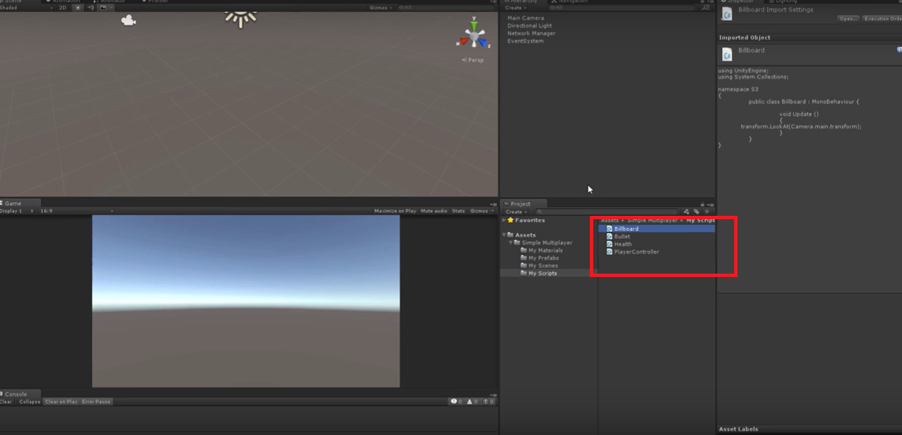

Slide 33
